Slide 1


Presented By :
A.Akshaya B.Pranavi

Slide 2
ONLINE STORE CART AND ORDER PIPELINE
Team No: 13
STUDENT NAME : A.Phani Sai Akshaya ROLL NO: 2620030308
STUDENT NAME: B.Pranavi ROLL NO: 2620030520

Slide 3
Online Store Cart and Order Pipeline — Abstract
The Online Store Cart and Order Pipeline is a Java-based software application designed to simplify and automate the management of products, customers, shopping carts, and orders in an online store. Traditional shopping systems may require manual handling of product information, stock availability, customer details, and order processing, leading to errors and inefficient management. The proposed system provides a centralized platform for managing these activities in an organized and user-friendly manner.
The system allows administrators to add, view, search for, and manage product records that include details such as product ID, product name, category, price, quantity, and availability. It also maintains customer information, including customer ID, name, phone number, and email. Customers can select available products and add them to their shopping cart. The cart stores selected products, quantities, prices, and the total purchase amount. The system checks product availability before adding items to the cart and helps maintain accurate stock information.
After completing the shopping process, customers can place an order using the items in their cart. Each order is assigned a unique order ID and contains details such as customer information, products, quantity, total amount, and order status. The Order Pipeline tracks an order through different stages: Cart → Order Placed → Processing → Shipped → Delivered. The system can also support order cancellation when required.
By automating these operations, the system reduces manual work, minimizes errors, saves time, and improves order management efficiency. The application can be further enhanced with online payment, discounts, delivery tracking, notifications, and customer reviews. Overall, the project provides a simple, efficient, and reliable solution for managing online store operations and the complete order processing cycle.

Slide 4
Understanding Problem Statement
Online shopping involves multiple steps, from selecting products to completing an order.
Managing the shopping cart, product quantity, pricing, and order details manually can lead to errors.
Customers need a simple way to add, remove, and update products in their cart.
The system should automatically calculate the total order amount based on the selected products and quantities.
After checkout, the order should move through a clear order processing pipeline.
The project aims to develop an efficient system that manages the cart and order process in an organized manner.

Slide 5
Problem:
Online stores need an efficient system to manage products selected by customers, calculate cart totals, and process orders accurately.
Objective:
To develop an Online Store Cart and Order Pipeline that manages cart operations and moves orders through the required processing stages in a structured way.

Slide 6
CO-1 Topics – Basic Operators
Definition:
Operators are special symbols used to perform operations on variables and values.
→Syntax: operand1 operator operand2;
Example: total = price * quantity;
→Arithmetic Operator Syntax :
result = operand1 + operand2;
result = operand1 - operand2;
result = operand1 * operand2;
result = operand1 / operand2;
result = operand1 % operand2;

Slide 7
CO-2 Topics - ITERATION/ LOOPS
Definition of Iteration:
Iteration means one repetition of a set of instructions in a loop.
An iteration is one complete execution or repetition of a loop.
There are 3 types of loops :
For loop
while loop
do-while loop

Slide 8
CO-3 TOPIC : ARRAYS
Definition Of Array :
An array is a data structure that stores multiple values of the same data type in a single variable.
Each value is stored at a specific index, starting from 0.
Syntax: dataType[] arrayName = new dataType[size]; (Declaration+size).
dataType[] arrayName = {value1, value2, value3};(Declaration+values).
Example:
int[] numbers = {10, 20, 30, 40};
→Index: 0 1 2 3
Value: 10 20 30 40
→ numbers[0] → 10
numbers[2] → 30

Slide 9
CO – 4 OBJECT ORIENTED PROGRAMMING(OOPS)
Introduction:
Object-Oriented Programming (OOP) is a programming approach where a program is designed using objects.
Class : A class is a blueprint or template for creating objects.
Object : An object is an instance of a class.
We can create multiple objects from one class.
this Keyword :The this keyword is a reference that refers to the current object.
→It is mainly used when the instance variable and constructor/method parameter have the same name.
Constructors : A constructor is a special member of a class used to initialize objects.
Has the same name as the class.
Does not have a return type.
Is automatically called when an object is created
Default Constructor : A default constructor is a constructor that takes no arguments.
Parameterized Constructor:
A constructor that receives arguments is called a parameterized constructor.
Constructor Overloading :
Constructor overloading means having multiple constructors in the same class with different parameter lists.
Fields :
Fields are variables declared inside a class.
Methods :
A method defines the behavior or action of an object.

Slide 10
Encapsulation:
Encapsulation is defined as the process of wrapping data and the methods into a single unit, typically a class. It is the mechanism that binds together the code and the data.
Inheritance :
Inheritance is a fundamental concept in OOP(Object-Oriented Programming).
Inheritance use extends keyword to inherit from a class
the different types of inheritance which are supported by Java.
Single Inheritance
Multilevel Inheritance
Hierarchical Inheritance
Multiple Inheritance
Hybrid Inheritance

Slide 11
Single Inheritance: a sub-class is derived from only one super class. It inherits the properties and behavior of a single-parent class.
Multilevel Inheritance: In Multilevel Inheritance, a derived class will be inheriting a base class, and as well as the derived class also acts as the base class for other classes.
Hierarchical Inheritance: In Hierarchical Inheritance, one class serves as a superclass (base class) for more than one subclass.
Multiple Inheritance (Through Interfaces):
one class can have more than one superclass and inherit features from all parent classes. Please note that Java does not support multiple inheritances with classes. In Java, we can achieve multiple inheritances only through Interfaces.
Hybrid Inheritance: It is a mix of two or more of the above types of inheritance.
Polymorphism : Polymorphism means "many forms", and it comes from the Greek words poly (many) and morph (forms).
There are two types:
Method Overloading: The return type of these methods can or cannot be same.
Method Overriding: the same name, return-type and parameters as in parent class.

Slide 12
Abstract Class :
abstraction is the process of hiding certain details and showing only essential information to the user.
The abstract keyword is a non-access modifier, used for classes and methods.
Abstract class: is a restricted class that cannot be used to create objects (to access it, it must be inherited from another class).
Abstract method: can only be used in an abstract class, and it does not have a body. The body is provided by the subclass (inherited from).
Interfaces : An interface is a completely "abstract class" that is used to group related methods with empty bodies.
Interface methods do not have a body - the body is provided by the "implement" class.
Interface methods are by default abstract and public.
Interface variables are by default public, static and final.

Slide 13
CO – 5 STRINGS
StringBuilder
StringBuilder is mutable: we can change its contents without creating a new String for every modification.
StringBuilder sb = new StringBuilder("Hello");
sb.append(" Java");
sb.append(" Programming");
System.out.println(sb); // Hello Java Programming
Common methods:
append()
insert()
delete()
replace()
reverse()

Slide 14
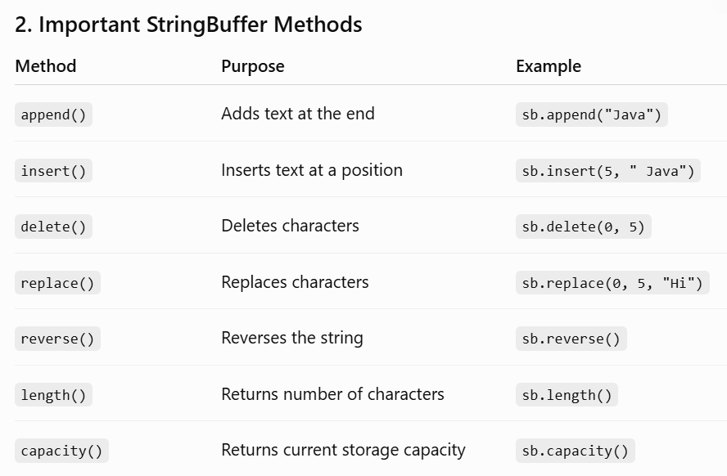
StringBuffer:
StringBuffer is also mutable.
StringBuffer sb = new StringBuffer("Hello");
sb.append(" World!");
System.out.println(sb);
Parsing Text Using split():
→split() is a method of the String class.
→It divides a string into smaller parts based on a delimiter.
Trimming:
→Trimming means removing unnecessary spaces from the beginning and end of a string.
→Java provides the trim() method.

Slide 15
CO-6 FUNCTIONAL PROGRAMMING WITH COLLECTIONS &STREAMS
Java Collections Framework (JCF) :
The JCF provides a unified architecture in the java. util package to store, manipulate, and manage groups of objects efficiently.
List: Stores elements in a sequence and allows duplicates. It features fast random access via indices but slow insertions/removals in the middle due to element shifting. (e.g., ArrayList)
Set: stores unique elements only and does not guarantee insertion order. (e.g., HashSet)
Map : Stores data as key-value pairs. Keys must be completely unique, while values can be duplicated. (e.g., HashMap)
Ordered Collections: Used when a specific ordering rule is required:
→TreeSet / TreeMap: Elements or keys are automatically sorted in natural order.
→LinkedHashSet / LinkedHashMap: Maintains the exact insertion order of items.

Slide 16
Generics & Type Safety
Definition: Generics allow you to specify the exact data type a collection can hold (e.g., ArrayList<String>).
Autoboxing and Unboxing
Autoboxing: Automatic conversion of primitive data types (like int, double) into their corresponding object wrappers (Integer, Double) because collections can only store objects.
Unboxing: Automatic conversion of the wrapper object back into its primitive form.
Collection Iteration Techniques
For-each Loop: Best used for simple, readable, and sequential traversal of a collection.
Iterator: An object used to move through a collection sequentially. It is the only safe method to remove elements dynamically during iteration using iterator.remove().
Declarative Processing: Shifting from how to do a task (imperative loops) to what
result is needed using Java Streams.
Functional Programming Elements
Functional Interface: An interface containing exactly one abstract method (e.g., @FunctionalInterface).
Lambda Expressions: Concise, unnamed blocks of code used to implement functional interfaces directly ((parameters) -> expression).
Method References: Uses the :: operator to directly point to an existing method instead of rewriting it as a lambda expression (e.g., System.out::println).

Slide 17
Java Stream API
Streams process data pipelines from a collection without altering the underlying data source. A stream pipeline can only be consumed once.
Intermediate Operations (Transform Streams)
filter(): Selects elements matching a given predicate condition.
map(): Transforms each element into another form.
sorted(): Sorts the elements in natural or custom order.
distinct(): Strips away duplicate values.
limit(n): Truncates the stream to only keep the first n items.
Terminal Operations (Produce Results / Trigger Execution)
forEach(): Iterates over each element to execute an action.
collect(): Gathers the final stream elements into a collection or summary structure.
count(): Evaluates the total number of remaining items as a long value.
reduce(): Aggregates stream elements into a single accumulated result.

Slide 18
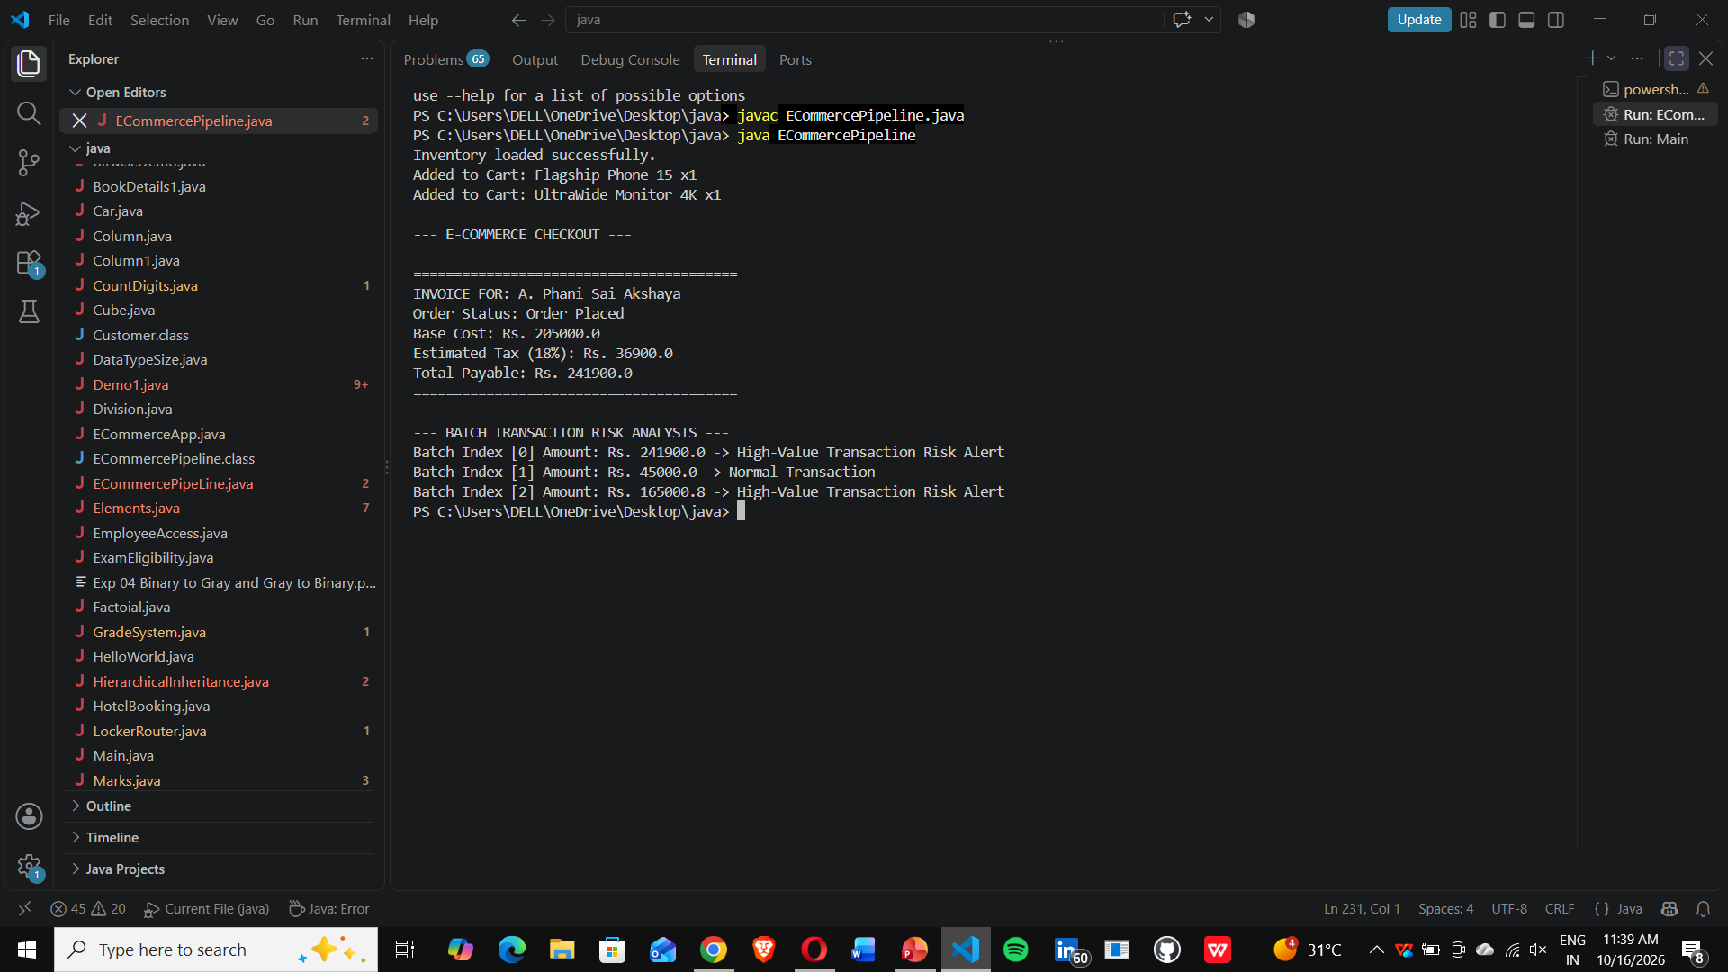
Output :

Slide 19
Conclusion
Streamlined Automation: Successfully automates the entire e-commerce process from product selection to final order delivery.
Core Java Framework: Effectively implements OOP concepts, Collections, and Stream APIs for a structured and efficient codebase.
Zero Manual Errors: Eliminates calculation mismatches and stock discrepancies through automated cart tracking and availability checks.
Clear Pipeline Visibility: Provides seamless tracking across all major delivery lifecycle stages (Cart → Placed → Processing → Shipped → Delivered).
Scalable Design: Built on a highly modular architecture that is ready for future payment gateway and notification upgrades.

Slide 20
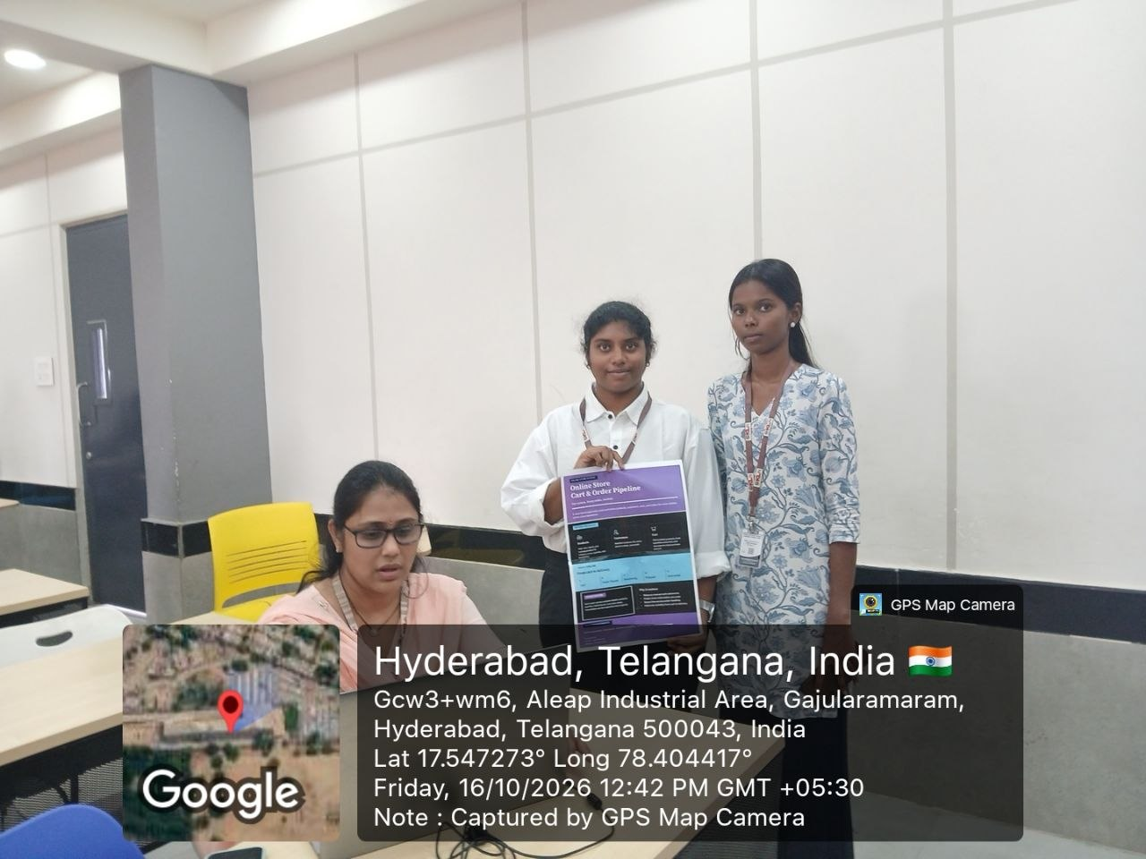
Geo Tag Photo and git hub link:
GitHub link: https://github.com/annampudiphanisaiakshaya-dotcom
GitHub link: https://github.com/pranavibobbilapaty-17/online-store-card.git
Geo Tag Photo :

Slide 21




